Slide 1
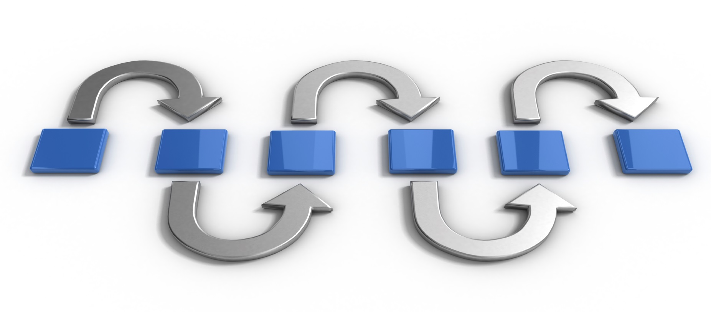
SDLC METHODOLOGIES
Arunraj R.
Business Analyst

Slide 2

AGENDA
What is SDLC?
Different stages of SDLC
Different types of SDLC Models
Comparison of Traditional and Agile Methodology.

Slide 3

What is
SDLC ?

Slide 4

Software Development Life Cycle
It is a process used by software industry to design, develop and test high quality software's.

Slide 5

DIFFERENT STAGES OF SDLC

Slide 6

PLANNING and requirements analysis

Slide 7

DEFINE
requirements

Slide 8
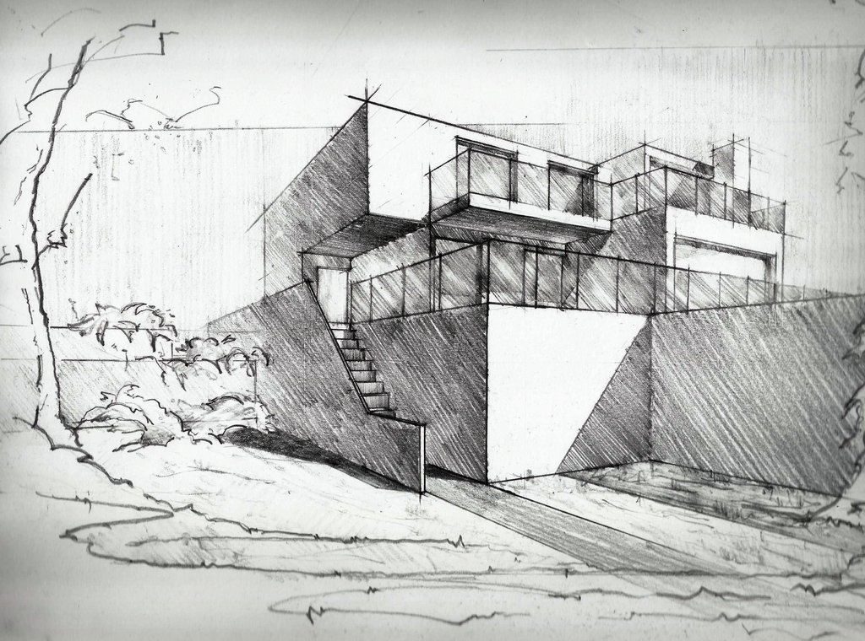
DESIGN

Slide 9

BUILD

Slide 10

TEST

Slide 11

DEPLOY

Slide 12

MAINTAIN

Slide 13

DIFFERENT SDLC models

Slide 14

Traditional methodology
agile methodology
Waterfall Model
Iterative Model
Spiral Model
V Model
Scrum
Test Driven Development
Extreme Programming
Crystal, BDD, FDD and more……

Slide 15
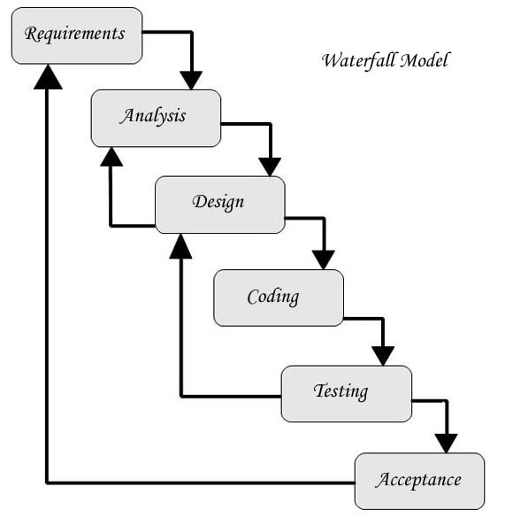
Waterfall model

Slide 16
WHEN TO USE THE WATERFALL MODEL:
This model is used only when the requirements are very well known, clear and fixed.
Product definition is stable.
Technology is understood.
There are no ambiguous requirements
Ample resources with required expertise are available freely
The project is short.
Very less customer enter action is involved during the development of the product. Once the product is ready then only it can be demoed to the end users. Once the product is developed and if any failure occurs then the cost of fixing such issues are very high, because we need to update everywhere from document till the logic.

Slide 17
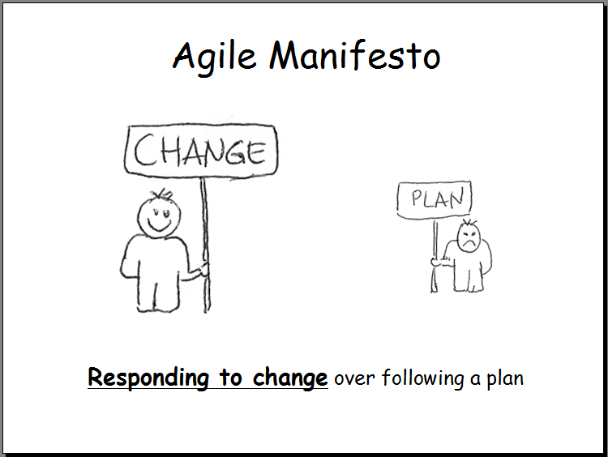
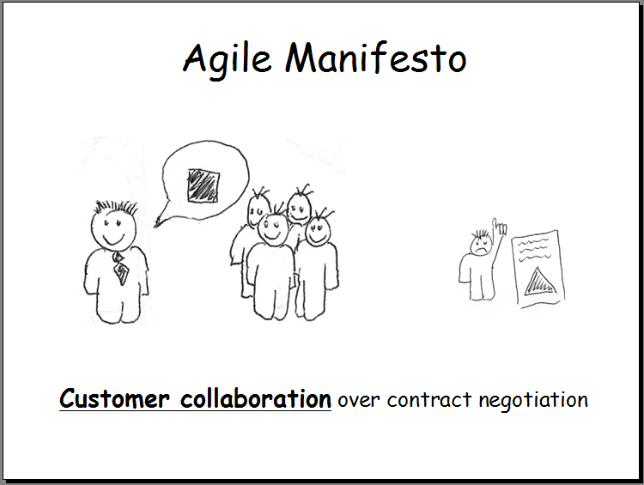
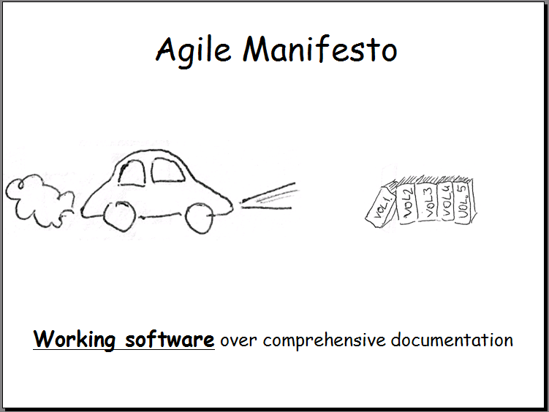
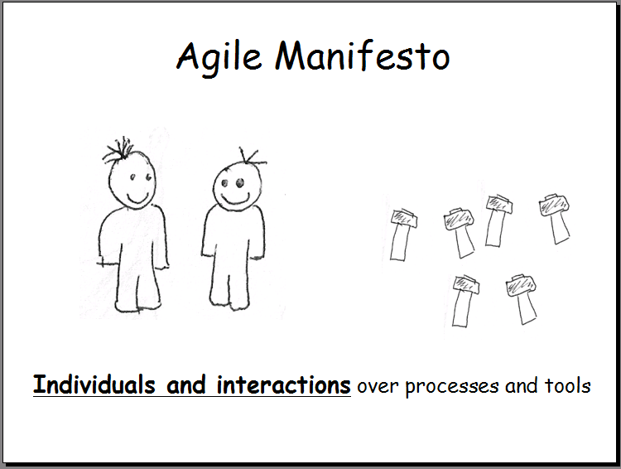
Agile MANIFESTO

Slide 18
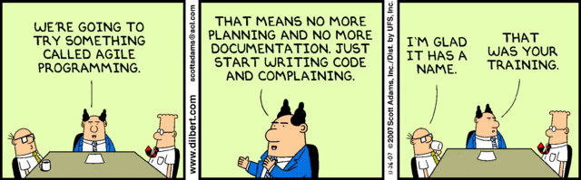
Agile methodologies

Slide 19
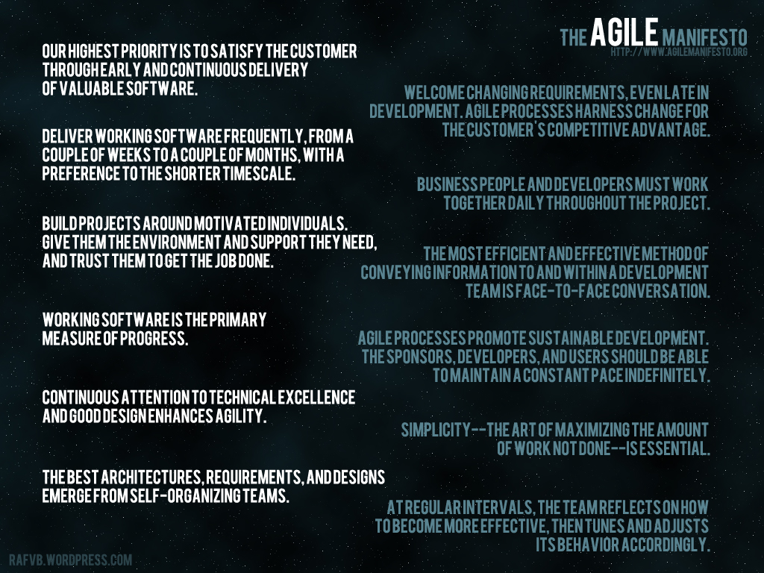

Slide 20
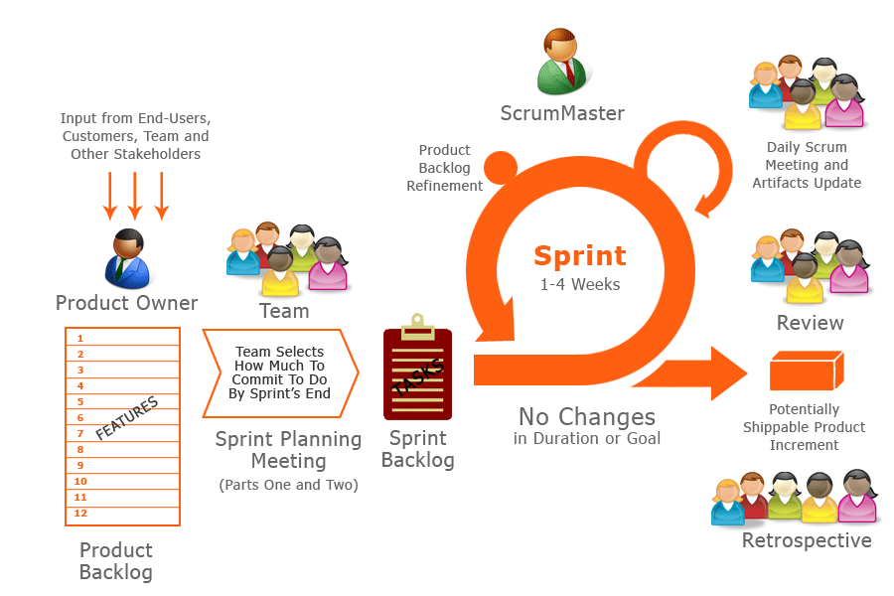
SCRUM

Slide 21
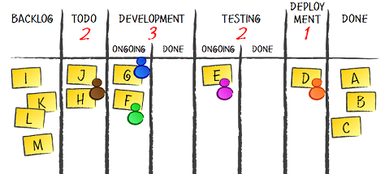
KANBAN BOARD

Slide 22
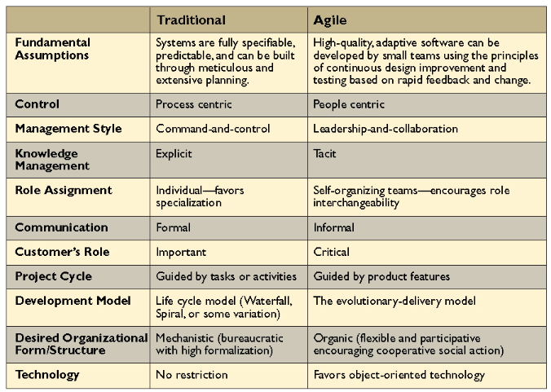

AGILE
TRADITIONAL

Slide 23
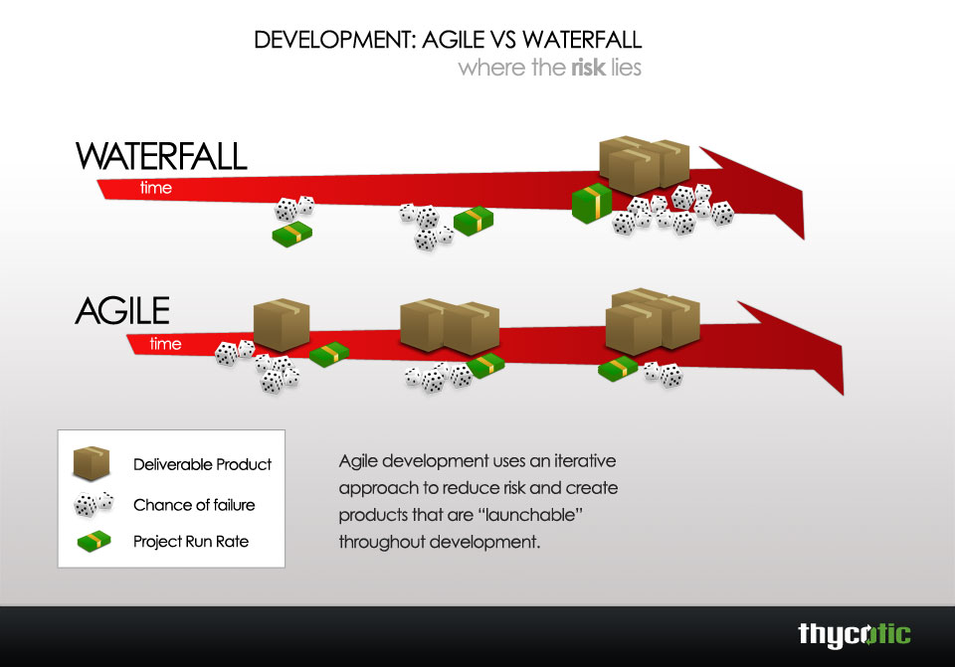

Slide 24

ANY
QUESTIONS/FEEDBACKS ?

Slide 25


** All images shamelessly stolen from GOOGLE.

